Slide 1
Thanks to Dear Santosh Sir
To provide me an idea to research on the Quantum Computing
And
Presenting
Quantum Computer

Slide 2
What do we do after the digital computers ? What’s the next revolution in the computing?
?
Quantum Computing
…………………
Transforming the Digital Age
Notes:
45709522510961

Slide 3
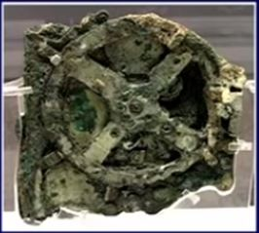
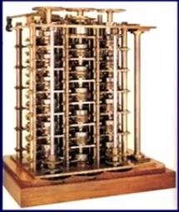
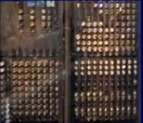
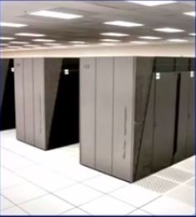
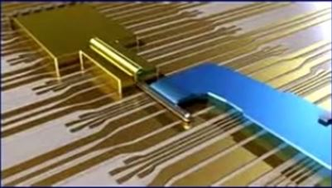
Computers have come a long way
Antikythera mechanism
100 BC
Babbage’s Difference Engine
Proposed 1822
Eniac
1946
D-wave
Sequoia
2012
(Topological) 2014
Quantum Computer

Slide 4
Success of Digital Computers and Moore’s Law
Number of transistors are doubling every 18 month
We have been following this trend to upgrade our computer processor
And now in this age the problem is :
we have been hitting by power law of physics
We will not be able to continue to double the number of transistors on its chip every 18 month
We simply cannot power the chip

Slide 5
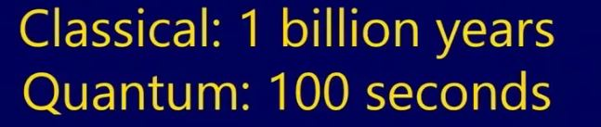
So What do we do when we hit the end of moore’s law ????????
Is there any thing that we cannot solve on the
digital computers?
!
!
Some Problems Intractable Classically
Like : RSA – 2048 Challenge problem
Took ->

Slide 6
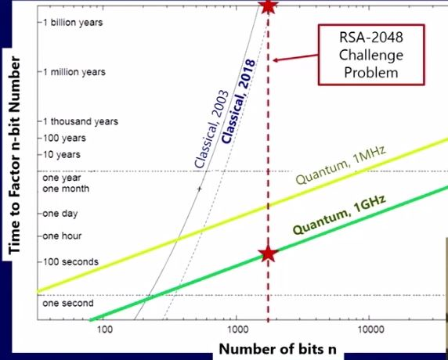
Factoring

Slide 7
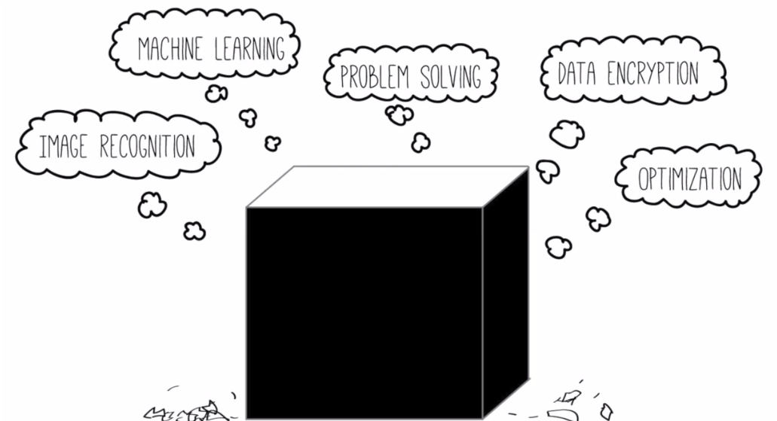
Quantum Computing Probably used for:
Complex
Calculation of finding
Optimal Solns of
Complex problem

Slide 8
Machine learning
Design apps that can see, hear, and understand
Classical deep learning uses approximation train efficiently
The problem in Artificial Intelligence
How do we make computers that see listen and understand?
Goal: learn complex representation that can be used to solve very hard problem in artificial intelligence
Challenges and Opportunities:
Terabytes of (unlabeled) web data
No " silver bullet" approach to learning
Can we automatically learn these representation?
Does quantum offer new representations ?
New training method?

Slide 9
Quantum mechanics is the ultimate parallel computer
Quantum mechanics considers all paths at once
So lets talk about what that means ……….

Slide 10
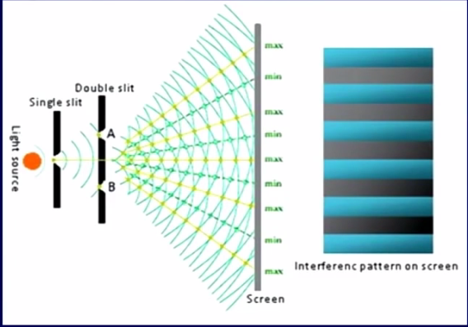
Quantum Magic Interference
Interference pattern
=
Quantum Coherence
Source of
particles
Classical Objects go either way
Quantum Objects(electrons, protons) go both ways.
Give Quantum Computing an inherent type of parallelism

Slide 11
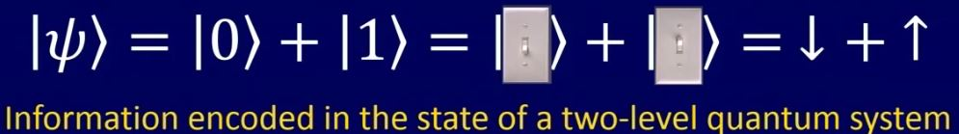
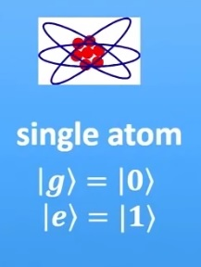
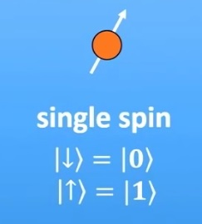

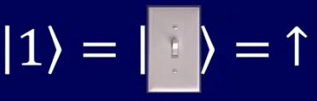
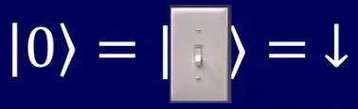
Qubits & Superposition
Super Position
Ground state or excited state

Slide 12
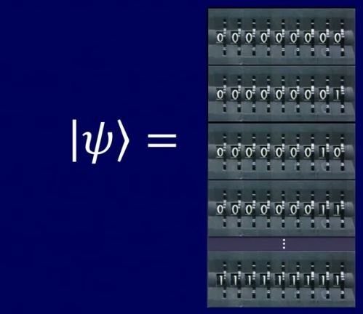
That’s just an example of one Qubit
Now If I give you a lot of Qubits
# example of 9 qubits
each one of these is a qubit
infact what this tells us is these can be simultaneously superposition of all of these states
so with 9 qubits i have superposition of 2^9 values here - all strings of zeros and ones and its all possible combinations
so this gives us massive parallelism
and we can use it to compute

Slide 13
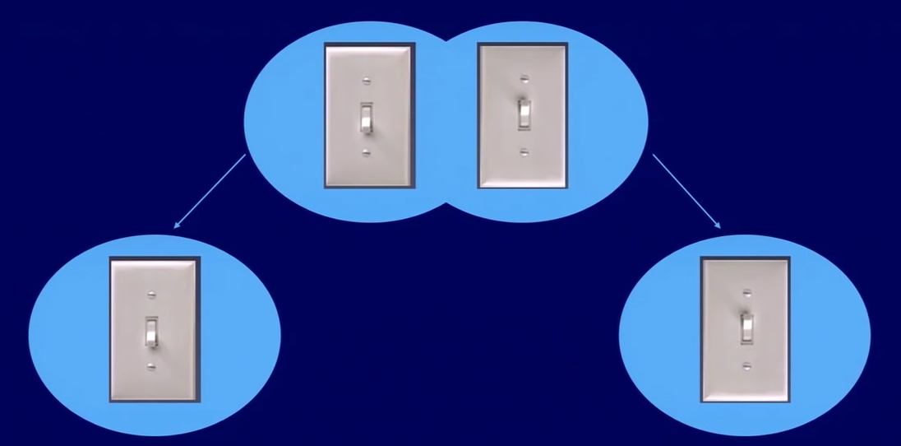
Entanglement
we can apply some gates to our qubits
and we can actually create an entangled state
and this is another resource we use within our quantum algorithm
So in entanglement , take one of the qubit far away across the universe
but if its in entangled state, if i do something to this qubit than something will be happening to another side qubit
type of non local correlation that i can get between qubits
This property is taken as advantage on quantum algorithm
Non Local Correlation

Slide 14
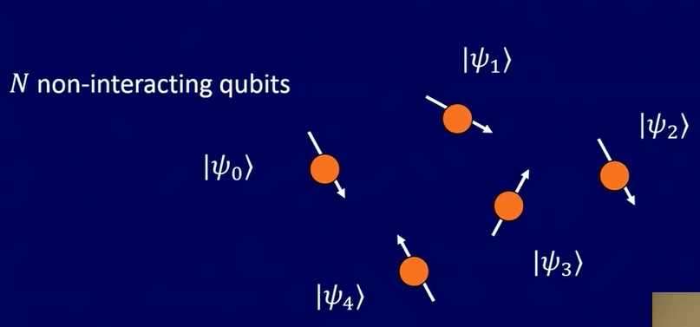
State of N non interacting qubits : ` N bits of info
we take 5 qubits (5 of these spins )
there is exponential difference on the way you treat with 5 qubits which are not entangled
(where we don’t get the power)

Slide 15
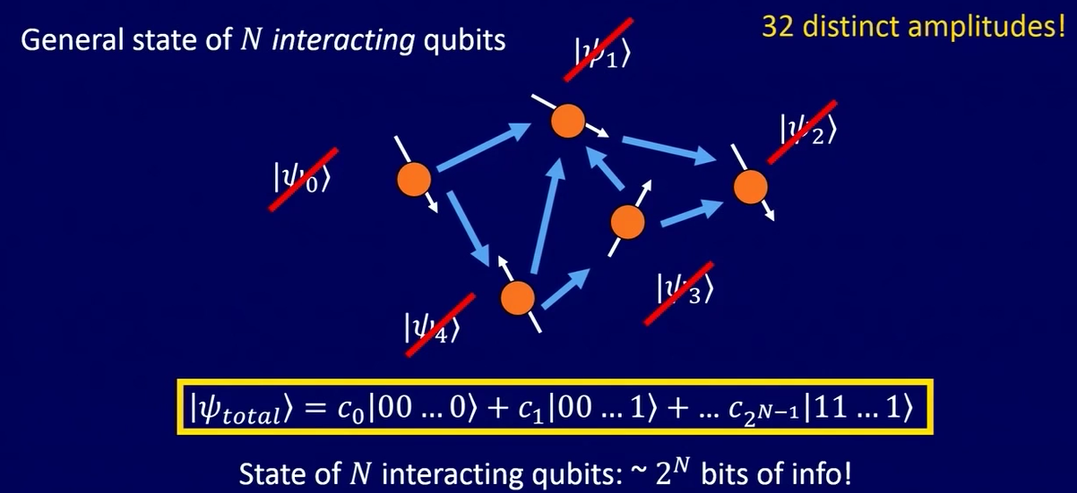
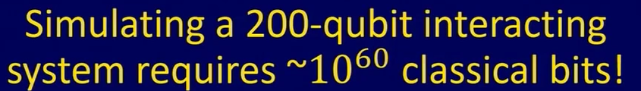
Entanglement
If they are all interacting , I can’t represent them as 5 separate states.
They are entangled and rely on each other holding 2^n bits of information.
..
Actually trying to reproduce that , we are going to need more atoms than this universe classically . __ 200 qubits is pretty powerful what if I have
1000 or 10,000 .????
..

Slide 16
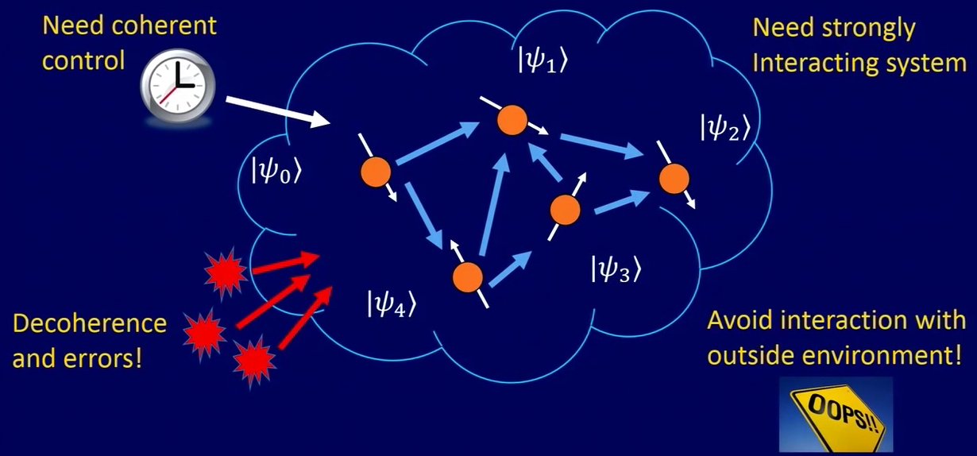
Challenges to build a Quantum Device

Slide 17
Requirements for Quantum Computaion
Quantum Algorithm:
Design real-world quantum algorithms for small-, medium- and large scale quantum computers
Quantum Hardware Architecture:
Architect a scalable, fault-tolerant, and fully programmable quantum computer
Quantum Software architecture:
Program a Compile Complex Algorithms into optimized, target dependent(quantum and classical) instructions
like : Visual Studio :- what does a VB look like for a quantum computer.

Slide 18
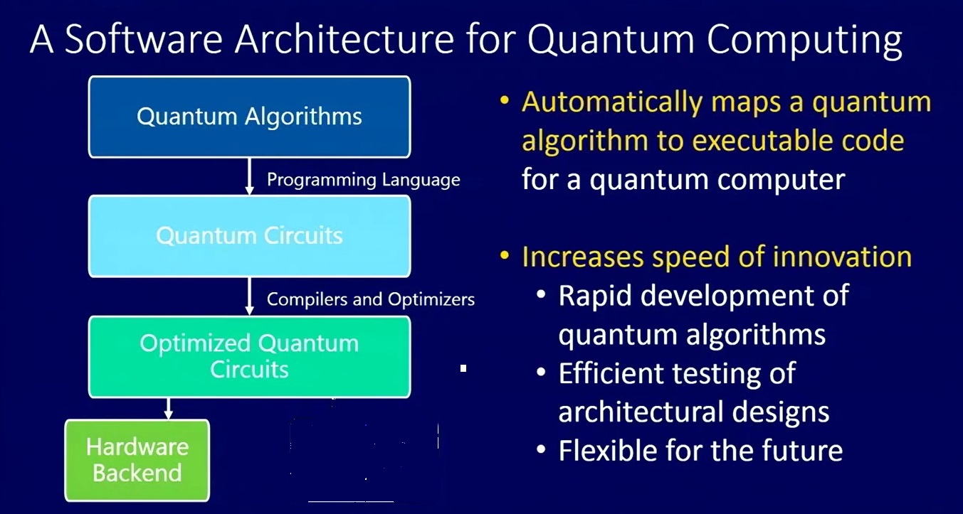

Slide 19
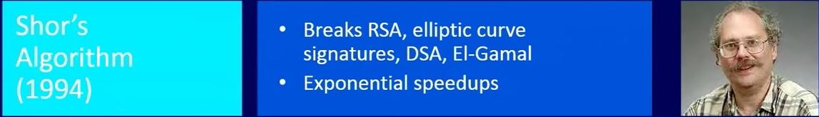
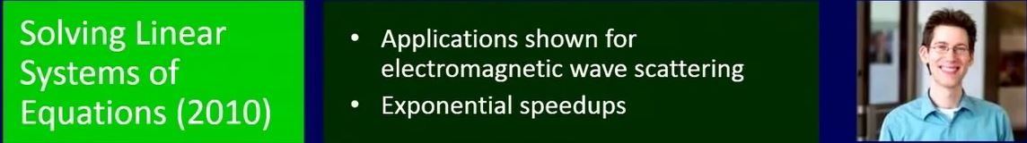
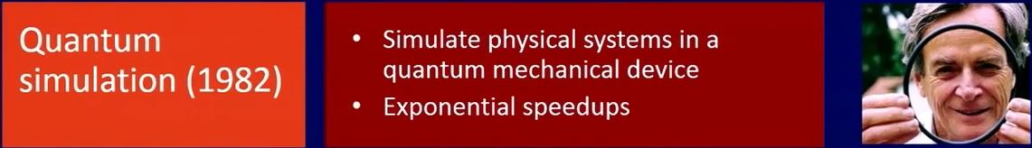
Quantum algorithm exists!!

Slide 20
Have a good Day Guys !!!!
O
)
O

